Slide 1
aesthetics

Slide 2
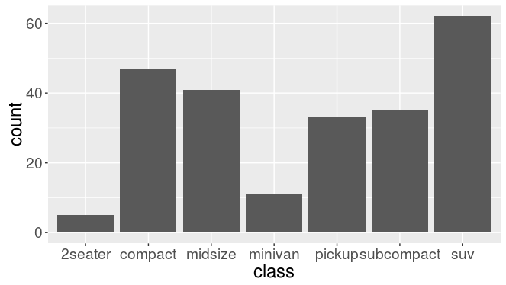
Raw Data
Table
Chart

Slide 3
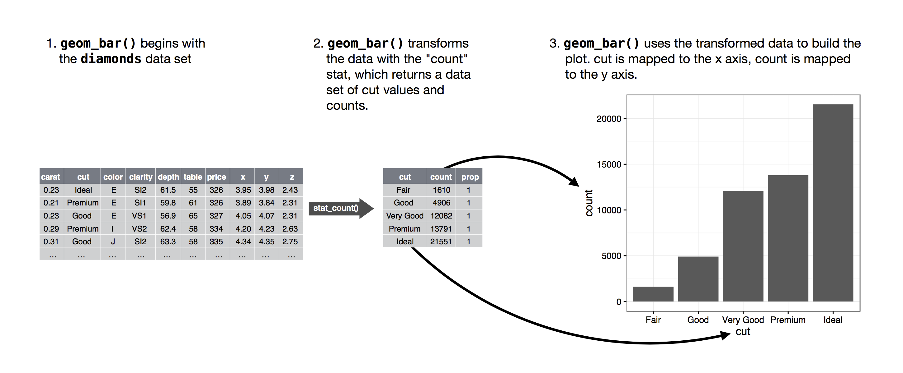
mpg
class
class values and

